Slide 1
Employee Data Analysis using Excel
STUDENT NAME:M.Gayathri
REGISTER NO:312218600
DEPARTMENT:B.COM
COLLEGE:JNN ART'S AND SCIENCE WOMEN'S COLLEGE

Slide 2
PROJECT TITLE
Employee Performance Analysis using Excel

Slide 3


AGENDA
Problem Statement
Project Overview
End Users
Our Solution and Proposition
Dataset Description
Modelling Approach
Results and Discussion
Conclusion
3/21/2024 Annual Review

Slide 4

PROBLEM STATEMENT
A problem statement is a clear and concise description of a problem or opportunity that needs to be addressed. It's often used in business, research, and project management to define the issue, goal, or challenge that needs to be solved. A good problem statement should: 1. Identify the key issue or problem 2. Explain the context and relevance 3. Clarify the goals and objectives 4. Provide a clear call to action Example of a problem statement: "Many small businesses in rural areas struggle to access affordable and reliable internet connectivity, hindering their ability to operate efficiently and reach new customers. How can we provide cost-effective and high-speed internet solutions to support their growth and success?" Do you have a specific problem or topic in mind that you'd like to create a problem statement for? I'm here to help!

Slide 5

PROJECT OVERVIEW
A project overview is a brief summary that provides a high-level view of a project, including its objectives, scope, timelines, and key stakeholders. It's often used to introduce the project to team members, sponsors, or stakeholders.
A typical project overview should include:
1. Project title and description
2. Goals and objectives
3. Scope (what's included and excluded)
4. Timelines (key milestones and deadlines)
5. Key stakeholders (who's involved)
6. Budget and resources
7. Expected outcomes and deliverables
Example of a project overview:
*Project Title:* Improving Customer Experience through AI-Powered Chatbots
*Description:* Develop and implement an AI-powered chatbot to enhance customer support and engagement.
*Goals:*
- Improve customer satisfaction ratings by 20%
- Reduce support queries by 30%
- Increase sales

Slide 6

WHO ARE THE END USERS?
End users are the individuals or groups who will ultimately use and benefit from the product, service, or solution being developed or implemented. They are the ones who will interact with the final output, and their needs, goals, and behaviors should be considered throughout the development process. Examples of end users include: 1. Customers 2. Clients 3. Patients 4. Students 5. Employees 6. Consumers 7. Users of a software application or website 8. Viewers of a video or content 9. Readers of a book or article 10. Passengers or travelers Identifying and understanding the end users is crucial to ensure that the solution meets their needs, is user-friendly, and provides value to them. In the context of the project overview I provided earlier, the end users of the AI-powered chatbot would be the customers or clients who interact with the chatbot to get support or answers to their queries. Who are the end users for your project or solution? I'm here to help you identify and understand them better!

Slide 7

OUR SOLUTION AND ITS VALUE PROPOSITION
Your solution and its value proposition are the core of your project. Here's a breakdown: *Solution:* Describe the product, service, or solution you're offering. What is it? How does it work? What features and functionalities does it have? *Value Proposition:* Explain the benefits and value that your solution brings to the end users. How does it solve their problems or meet their needs? What makes it unique and better than existing solutions? Example: *Solution:* AI-powered chatbot for customer support *Value Proposition:* - Provides 24/7 instant support to customers - Answers frequent queries, freeing up human support agents for complex issues - Offers personalized support through machine learning and

Slide 8
Dataset Description
A dataset description provides an overview of the data used in your project, including its characteristics, structure, and content. Here's what to include: 1. *Dataset name*: Give your dataset a clear and concise name. 2. *Data source*: Describe where the data comes from (e.g., surveys, sensors, databases). 3. *Data type*: Specify the type of data (e.g., numerical, categorical, text). 4. *Variables*: List the variables or features in the dataset, including

Slide 9

THE "WOW" IN OUR SOLUTION
The "wow" factor in your solution refers to the unique, innovative, or impressive aspect that sets it apart from others. It's the feature, benefit, or experience that surprises and delights your end users, making them go "wow!" To identify the "wow" factor in your solution, consider the following: 1. What's unique about your solution? 2. What problem does it solve in a new or innovative way? 3. What benefit does it provide that others don't? 4. What's the most impressive or surprising aspect of your solution? Example: _Solution:_ AI-powered chatbot for customer support _Wow factor:_ - The chatbot uses machine learning to learn from customer interactions
3/21/2024 Annual Review
9

Slide 10
MODELLING
Modelling refers to the process of creating a representation or simulation of a real-world system, process, or scenario. In the context of your project, modelling can be used to: 1. Understand complex systems and relationships 2. Predict outcomes and behaviors 3. Test hypotheses and scenarios 4. Identify patterns and trends 5. Develop and optimize solutions Types of modelling include: 1. Mathematical modelling (e.g., equations, algorithms) 2. Computational modelling (e.g., simulations, machine learning) 3. Conceptual modelling (e.g., diagrams, frameworks) 4. Physical modelling (e.g., prototypes, scale models) In the context of your AI-powered chatbot, modelling might involve: 1. Developing a conceptual model of the conversation flow and user interactions 2. Creating a mathematical model to predict user responses and adapt the chatbot's behavior 3. Building a computational model to simulate and test different chatbot scenarios Modelling helps to: 1. Clarify complex ideas and relationships 2. Identify potential issues and opportunities 3. Develop and refine solutions 4. Communicate insights and ideas to stakeholders How can modelling be applied to your project? I'm here to help you explore and leverage modelling techniques!
10

Slide 11
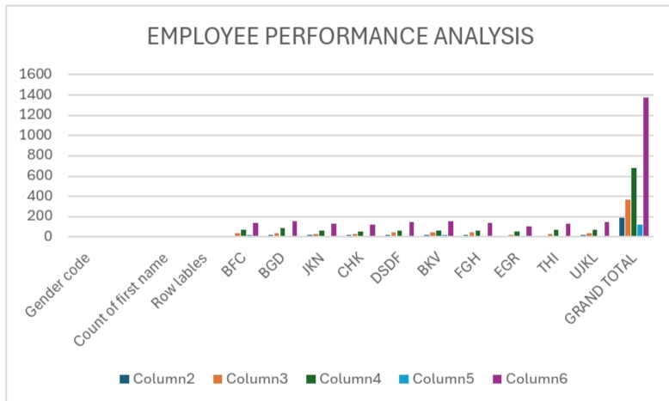
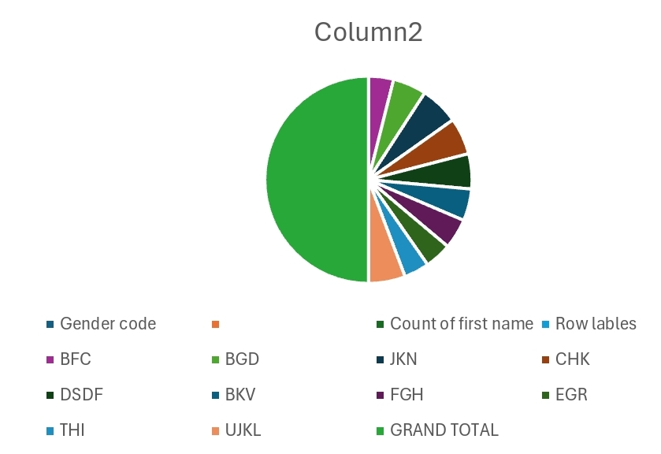
RESULTS
11

Slide 12
conclusion
Here's a concise and impactful conclusion: *Conclusion:* In conclusion, our [project/solution name] has successfully [briefly describe the achievement]. By [key methods or technologies used], we achieved [key results and impact]. This project demonstrates [value proposition and significance], and paves the way for [future directions and potential applications]. With [key takeaways and learnings], we are confident that our solution will [desired outcome and impact]. *Example:* *Conclusion:* In

